Slide 1
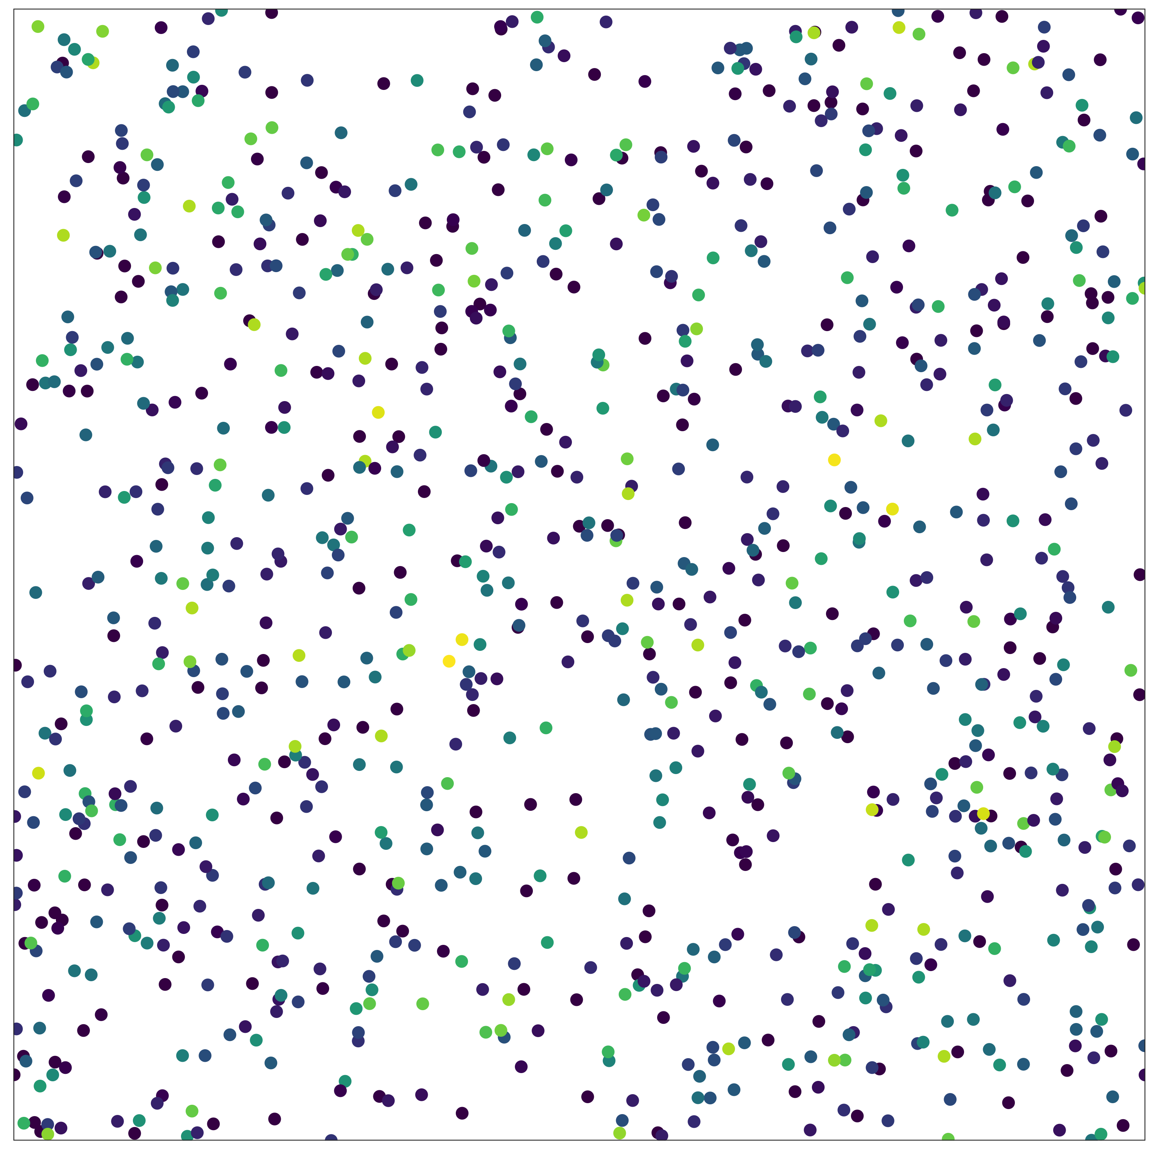
How to measure biodiversity?
Multiple components:
number of individuals (N)
relative abundance of species (evenness)
total number of species (richness)
Different metrics incorporate
these components to varying degrees, but key axes of variation are abundance, evenness and richness (McGill 2011)

Slide 2
How to measure biodiversity?
Multiple components:
number of individuals (N)
relative abundance of species (evenness)
total number of species (richness)
Different metrics incorporate
these components to varying degrees, but key axes of variation are abundance, evenness and richness (McGill 2011)
Want to use rarefaction to examine:
Component (abundance, evenness and richness) changes , and
Scale-dependent changes

Slide 3
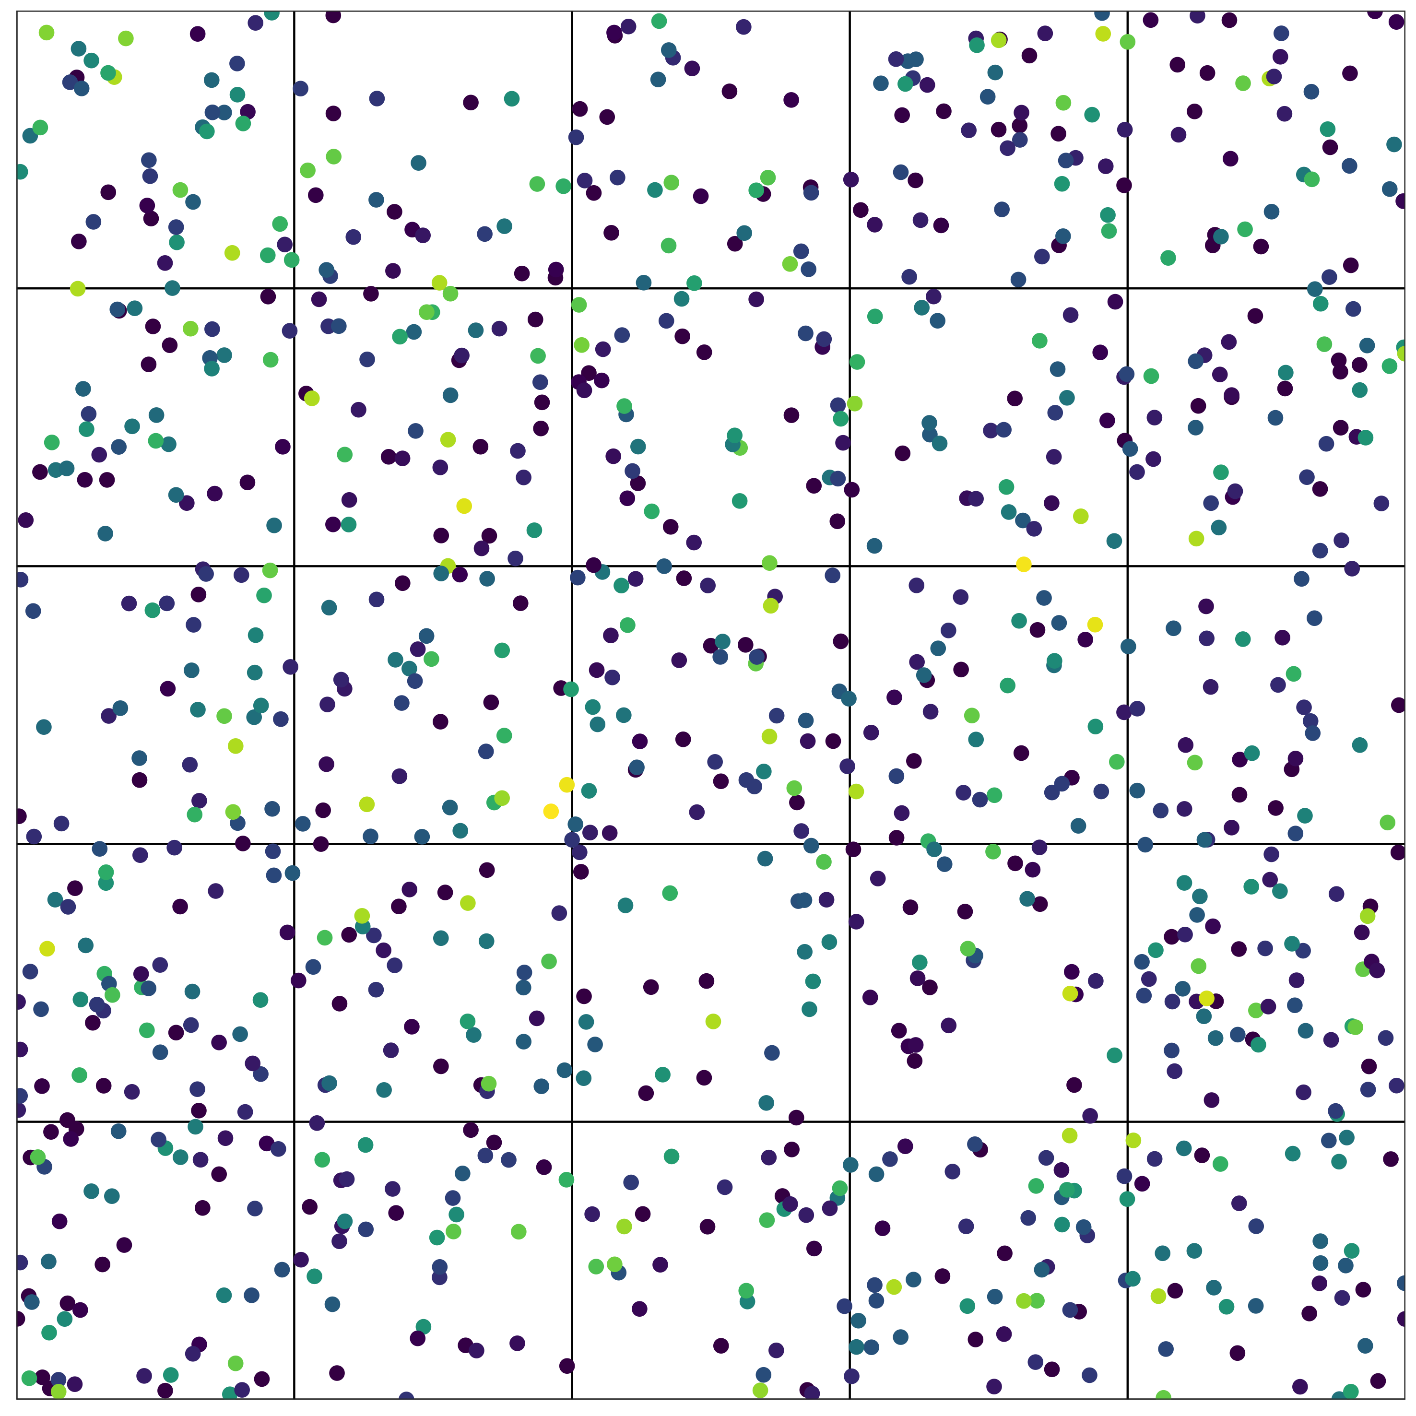
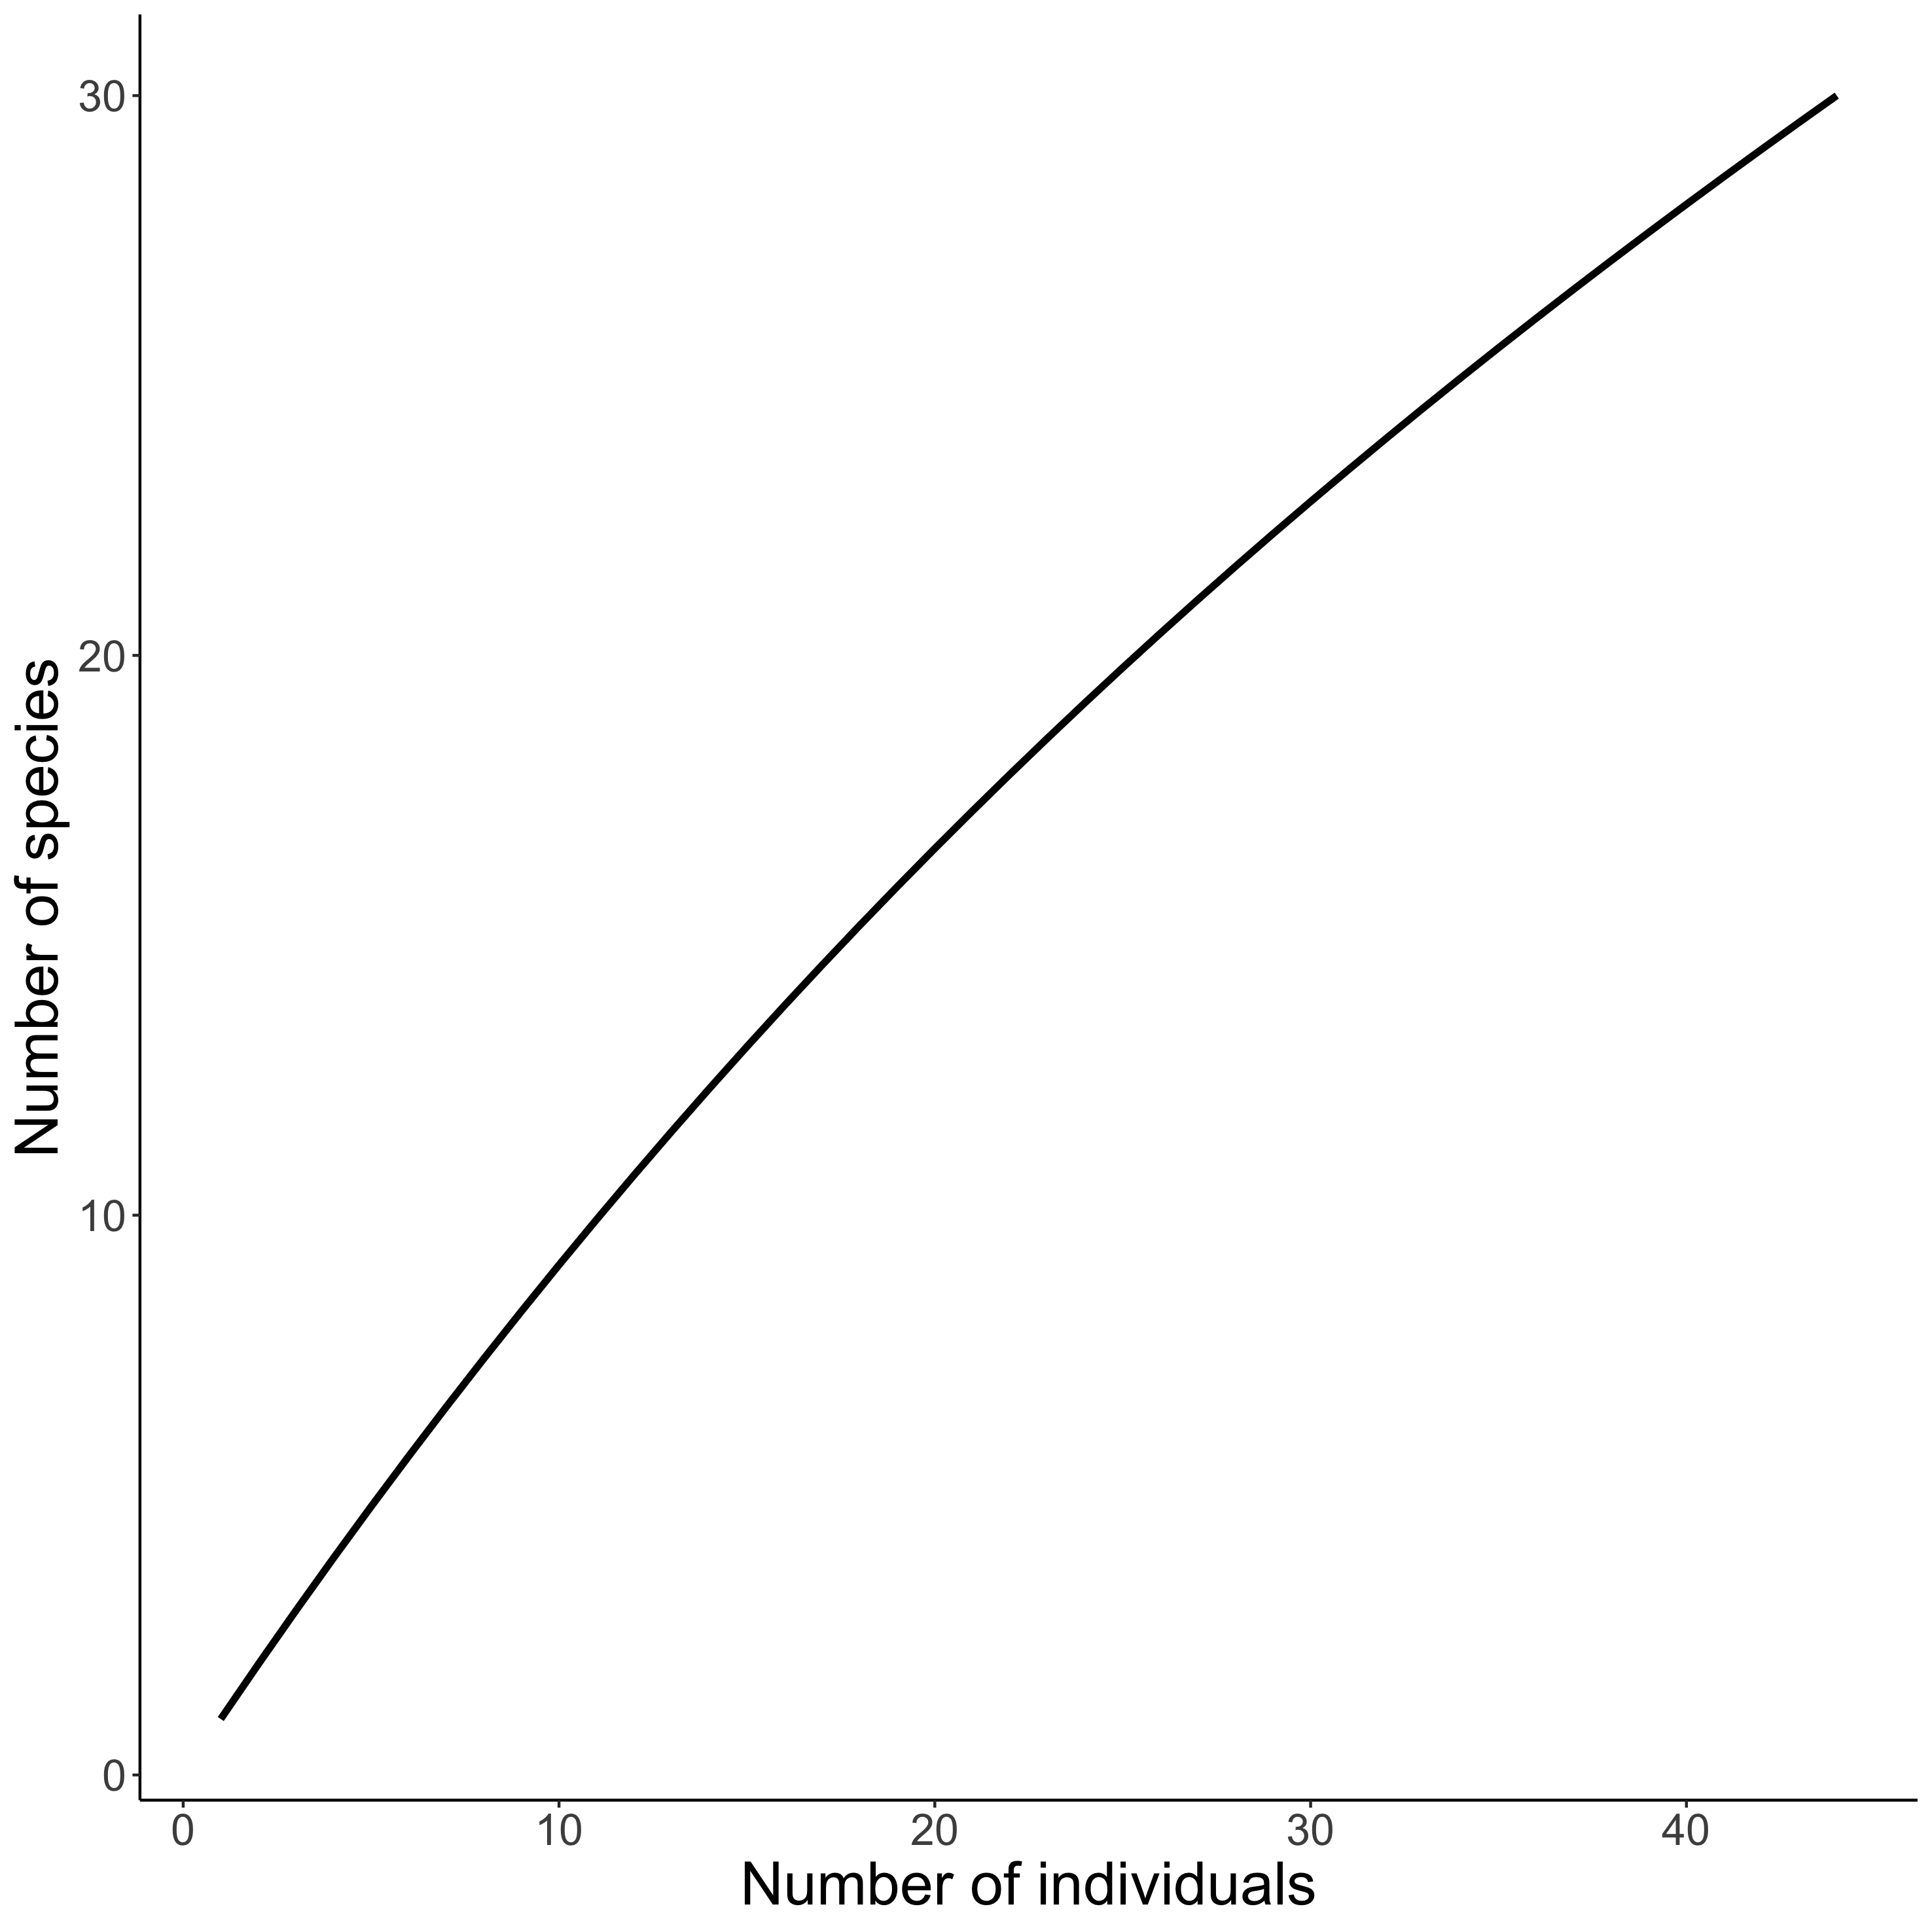
Visualising biodiversity through the lens of Individual Based Rarefaction (IBR)
𝛼-scale
Hurlbert 1971 Ecology, Gotelli & Colwell 2001 Ecol Lett

Slide 4
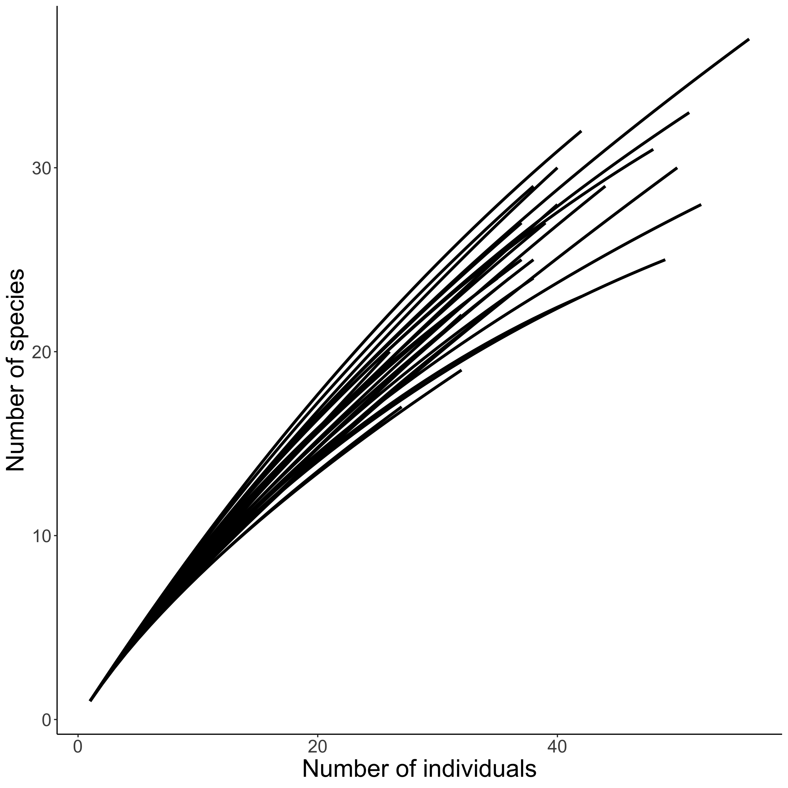
Visualising biodiversity through the lens of Individual Based Rarefaction (IBR)
𝛼-scale : each curve corresponds to one quadrat
Hurlbert 1971 Ecology, Gotelli & Colwell 2001 Ecol Lett

